Slide 1
Who Can Social Distance?
The impact of socioeconomic and behavioral factors on the effectiveness of COVID-19 mitigation policy
Ciara Patterson
April 22, 2021
Notes:
Hello, I’m Ciara. Today I’ll be presenting on “Who can Social Distance? A study of the impact of socioeconomic and behavioral factors on the effectiveness of COVID-19 mitigation policy”.

Slide 2
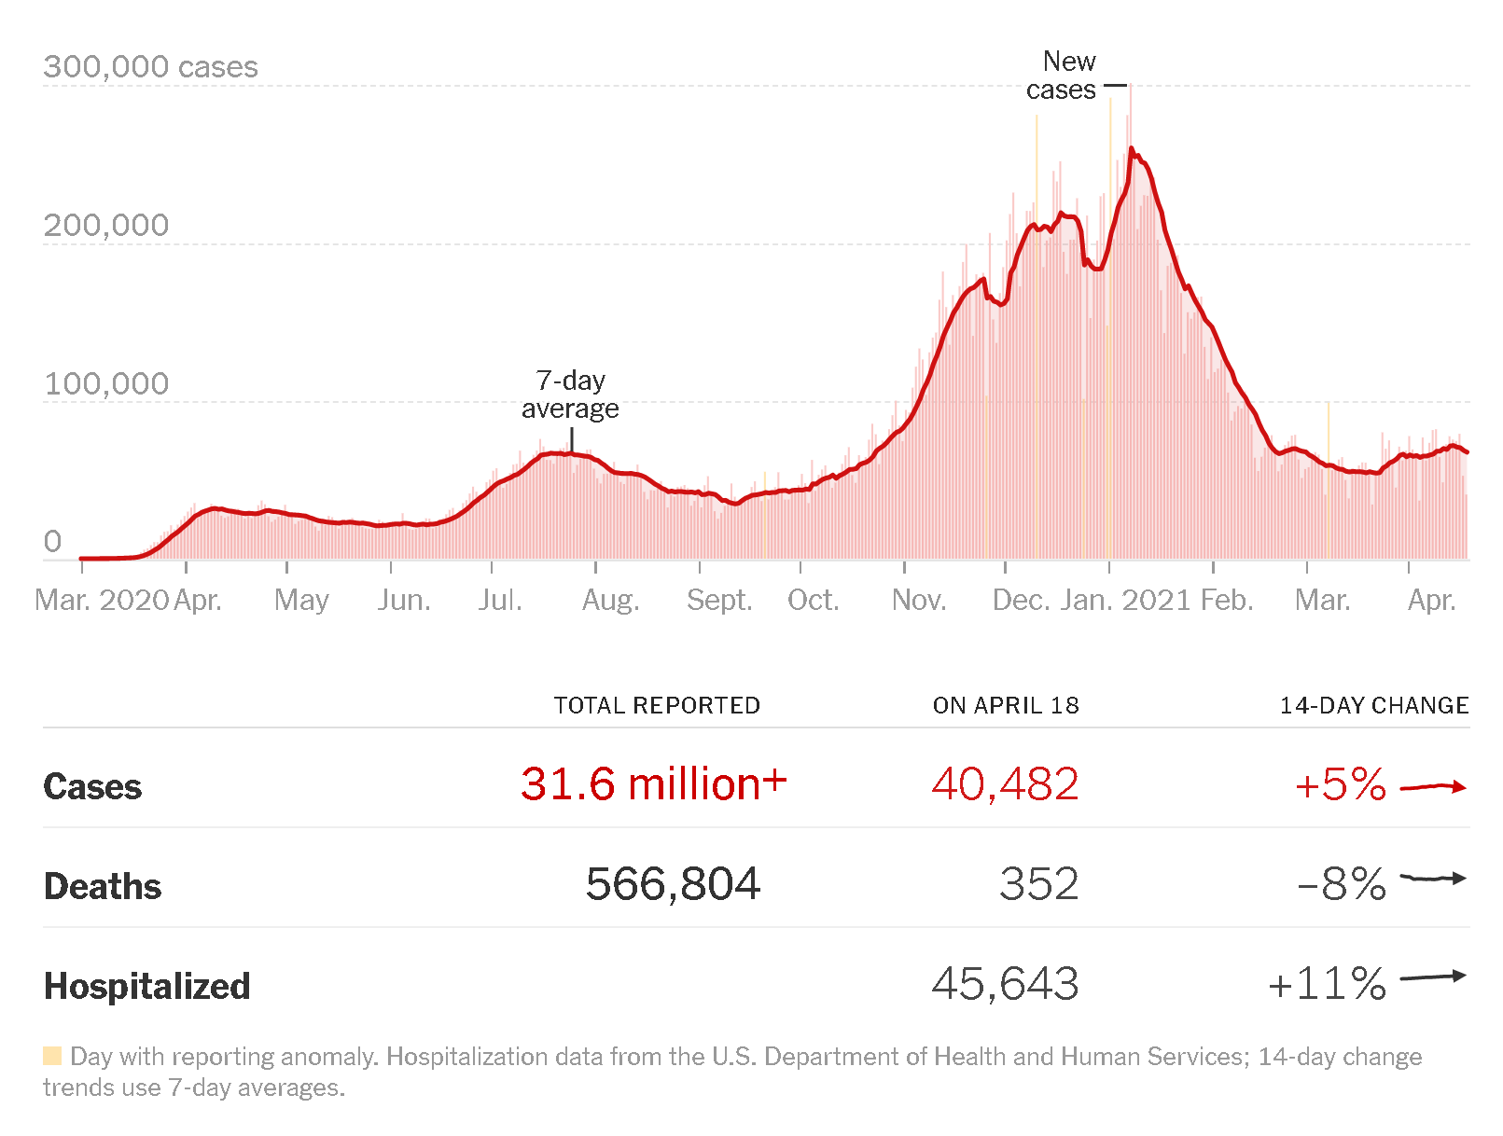
COVID-19 pandemic
Declared a pandemic on March 11, 2020 by the World Health Organization
Source: The New York Times
Notes:
On March 11, 2020 over a year ago today, the World Health Organization declared COVID-19 a pandemic, just 3 months after the World Health Organization announced that the 59 cases of pneumonia in Wuhan, China may be attributed to a novel coronavirus.
https://www.ajmc.com/view/a-timeline-of-covid19-developments-in-2020

Slide 3
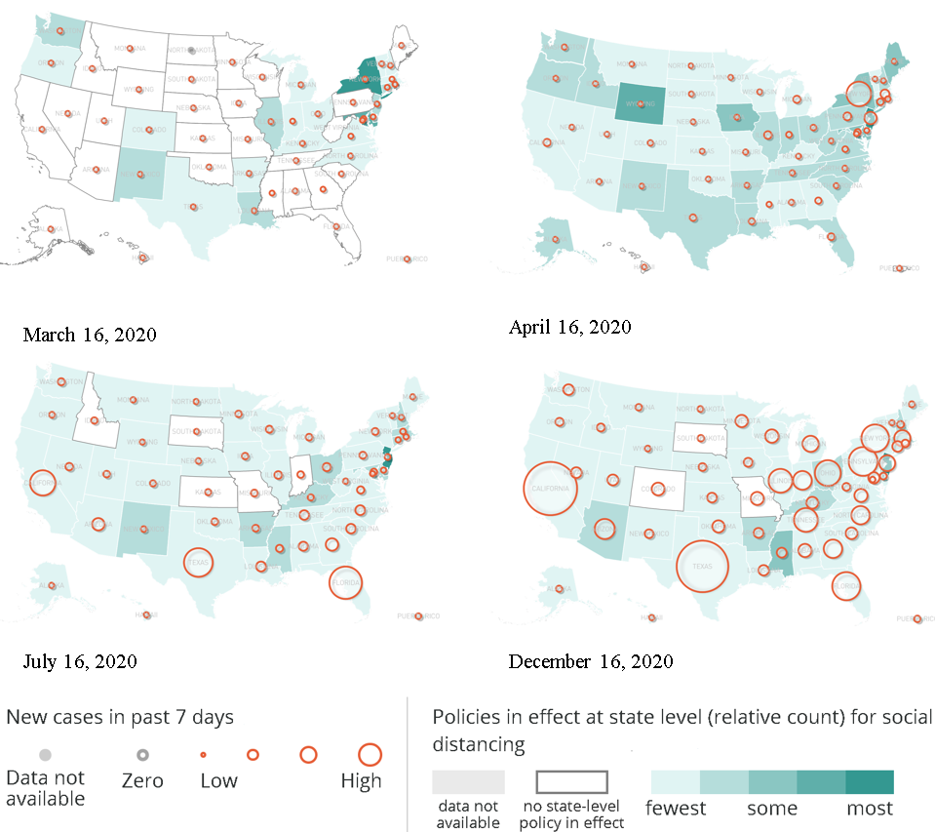
Policy response to COVID-19
Stay at home orders followed by a slew of restrictions
Adaptation and mitigation measures, private sector closures, mass gathering restrictions (shown in figure)
Select State-Level Social Distancing Policies
Notes:
8 days after COVID-19 is declared a pandemic, on March 19th, California becomes the first state to implement a statewide stay-at-home order. Decision makers are now tasked with determining how to best protect people from becoming infected. Businesses closed. People worked from home. Politicians begin to draft laws that encouraged or enforced social distancing. On the right, we can see a map of some select social distancing policies, specifically adaptation and mitigation measures, private sector closures, and mass gathering restrictions, implemented throughout the pandemic in the US and the number of new COVID-19 cases at the time.

Slide 4
Research questions
When do social distancing policies “work”?
Policy success is limited by both the ability and willingness of individuals to change their behavior
What non-policy related variables explain why some areas still see more COVID-19 cases than other areas with similar social distancing policies in effect?
Notes:
But what happens when policymakers “do everything right” and there are still cases of COVID-19? Why do some areas get hit harder than others, and how does COVID-19 spread when mitigation measures are in place. The success of any policy is limited by both the ability and willingness of people to comply with said policy.
Those questions led me to conduct a study to answer the question “What non-policy related variables, specifically those related to the socioeconomic status and behavior of an area’s residents, explain why some areas still see more COVID-19 cases than other areas with similar social distancing policies in effect?”

Slide 5


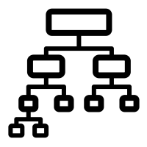

Overview of the research process
Data on which counties had social distancing policies in place and when
Data on the demographic makeup and behavior of those county’s residents
Data on the epidemic trajectory in those counties
A single dataset with all the above data for the relevant counties
Machine learning model
Predictions about the caseload in those counties
Notes:
To answer that question, we need to know a lot of information. The goal is to control for the impact of social distancing policies, so we can better understand whether factors like the income or occupation of a county’s residents impact the number of COVID-19 cases observed after mitigation policies are implement. We don’t want to compare the number of cases in places that were fully open with places that locked down, so we need to find out which areas had social distancing policies in place and when. We also need to know data about the demographic makeup and behavior of that area’s residents and information about the COVID-19 trajectory in those areas. We’ll be gathering this information at the county level since Counties are the smallest geographical unit for which COVID-19 data is widely available.
Once we have the information, we’ll need to see if we can actually predict which counties will see higher or lower numbers of COVID-19 cases from the socioeconomic and behavioral factors that we’ve collected earlier. And then ideally, we the model that we use to make those predictions can also tell us if say, the residents’ income level is associated with lower COVID-19 cases than the residents’ daily change in mobility or voting behavior.
So this is both the broad overview of how I conducted this research and the way I’ll be walking us through my work and findings today.

Slide 6
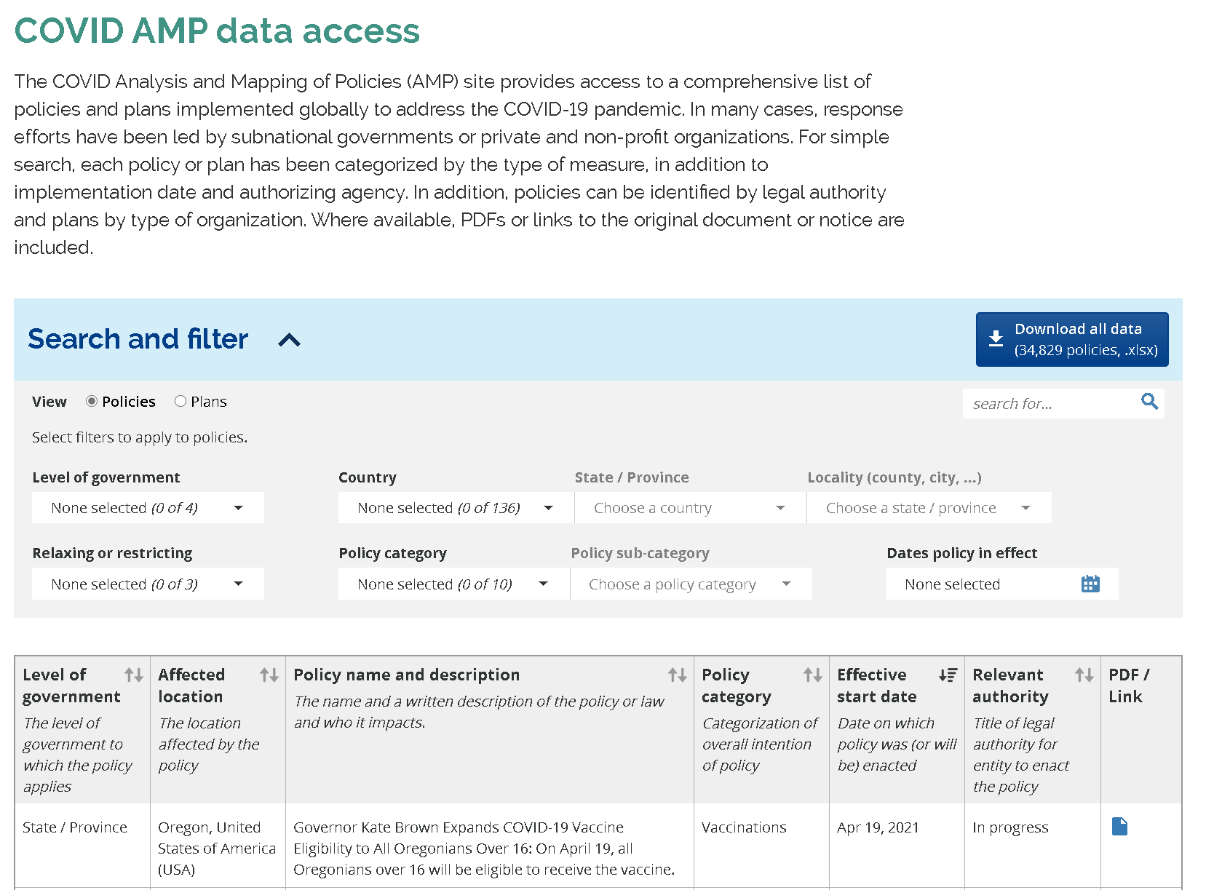
Introduction to COVID AMP
Database and visualization tool for COVID-19 response policies
Notes:
So first, we’ll talk about how I identified counties with social distancing policies in place. COVID AMP is an online database of policies and visualization and modeling tool for COVID-19 response policies implemented worldwide that’s been created and maintained by Talus Analytics in conjunction with Georgetown University. It’s designed to be used as a decision support tool for local policy makers and researchers. And while I will only be focusing on social distancing policies, it includes policies related contact tracing, and testing, hazard pay, etc. as well. Policies are hand coded into the database. Chose to use this resource because it contains very specific information which is necessary if we’re going to say that two counties had similar policy environments. And it also includes data at the state, local, federal, and international level.

Slide 7
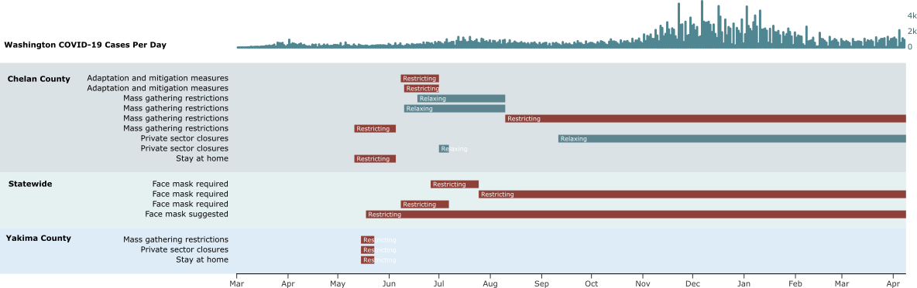
Example policy environment
Notes:
Here’s an example of why it’s often necessary to know policy data at multiple authorizing levels. This an example of a policy timeline of a few policies in 2 counties in Washington state, Yakima and Chelan. Notice how both counties have slightly different social distancing policies in place. Could be because they are different phases of Washington’s COVID-19 plan or because local leaders made different decisions. However, both are currently under a statewide mask mandate as well.

Slide 8
Controlling for policy
Face mask required
Private sector closures that either target all nonessential businesses or specifically restaurants and entertainment venues
Adaptation and mitigation measures or mass gathering restrictions
All policies considered must be restricting
Notes:
COVID-19 policy is deeply complicated and the data in COVID-AMP reflects all of the decisions that leaders have had to make from allowing marriage licenses to be obtained over zoom to requiring that certain signage be posted in restaurants. Rather than attempting to control for every policy, I chose to focus on a few select social distancing policies that had been focused on and found to be effective in the literature.
Face mask requirements (know face masks to be effective)
Private sector closures. Focus on specifically high risk businesses like restaurants, bars, entertainment venues, where people are unmasked and in close quarters for extended periods of time.
Adaptation and mitigation measures and mass gathering restrictions capture policies that are designed to limit or prevent the gathering of large crowds of people. Mass gathering restrictions refer to limits on the number of people that may gather at any given time whereas adaptation and mitigation measures may refer to “total occupancy limits” imposed on private businesses.
And all policies must be coded as restricting “Restricting.” Restricting is a relative term that refers to any policy that “was introduced to decrease the overall interactions and activity among individuals.” By contrast, some policies are tagged as “Relaxing” which means the policy’s aim was “to increase activity and interactions towards pre-outbreak levels.” I stated earlier that if we’re controlling for social distancing policies, we don’t want to be comparing an areas that’s seeking to reopen with one that’s fully locked down, so that’s why we only looked at restricting policies.

Slide 9
Features studied
Data Source
Features
Number of relevant citations
Safegraph Social Distancing Dataset
Percent increase in individuals staying at home*
Percent increase in median non-home dwell time*
Percent increase in home dwell time*
5
New York Times and Dynata Survey
Percent of survey respondents who reported frequently or always wearing a mask in public
2
MIT Election Data + Science Lab
Percent of voters who voted for the Republican presidential candidate in 2016
3
*Percent increase is measured from the first week of January to the first week of April
Notes:
Once I successfully identified counties with similar social distancing policies in place, it was time to collect data on the county’s residents. I conducted a literature review to identify what variables were being studied in the literature. Many of these features of the counties and datasets had already been studied in conjunction with COVID-19 cases and a meaningful connection had been found. However, no one had studied them all at once and attempted to understand the interplay.
So these are some of the behavioral variables studied including information about the residents’ mobility changes in response to the pandemic, whether or not they reported wearing a mask in public (taken from a survey conducted in July by the NYT) , and the percentage of people that voted for the Republican candidate Donald Trump in 2016.

Slide 10
Features studied
Data Source
Features
Number of relevant citations
ACS 2014-2018 occupation data weighted with Dingel and Neiman’s telework dataset
Estimate of the percentage of the population employed in an occupation that can be conducted from home (i.e. teleworkable)
2
CDC SVI 2018 (data from the 2014-2018 ACS 5-year estimates)
Percent of the population that is a racial minority (all persons except white, non-Hispanic)
Percent of households with more people than rooms
Percent of population over 65 years old
Percent of population below the poverty line
Population density
7
Notes:
I also gathered data on socioeconomic factors and demographics. I used 2 publicly available datasets to produce an estimate of what percentage of people in the area worked in jobs that they could work from home in. From the CDC and the American Community Survey, I collected information on the demographics, crowdedness, and income of people in the area.

Slide 11
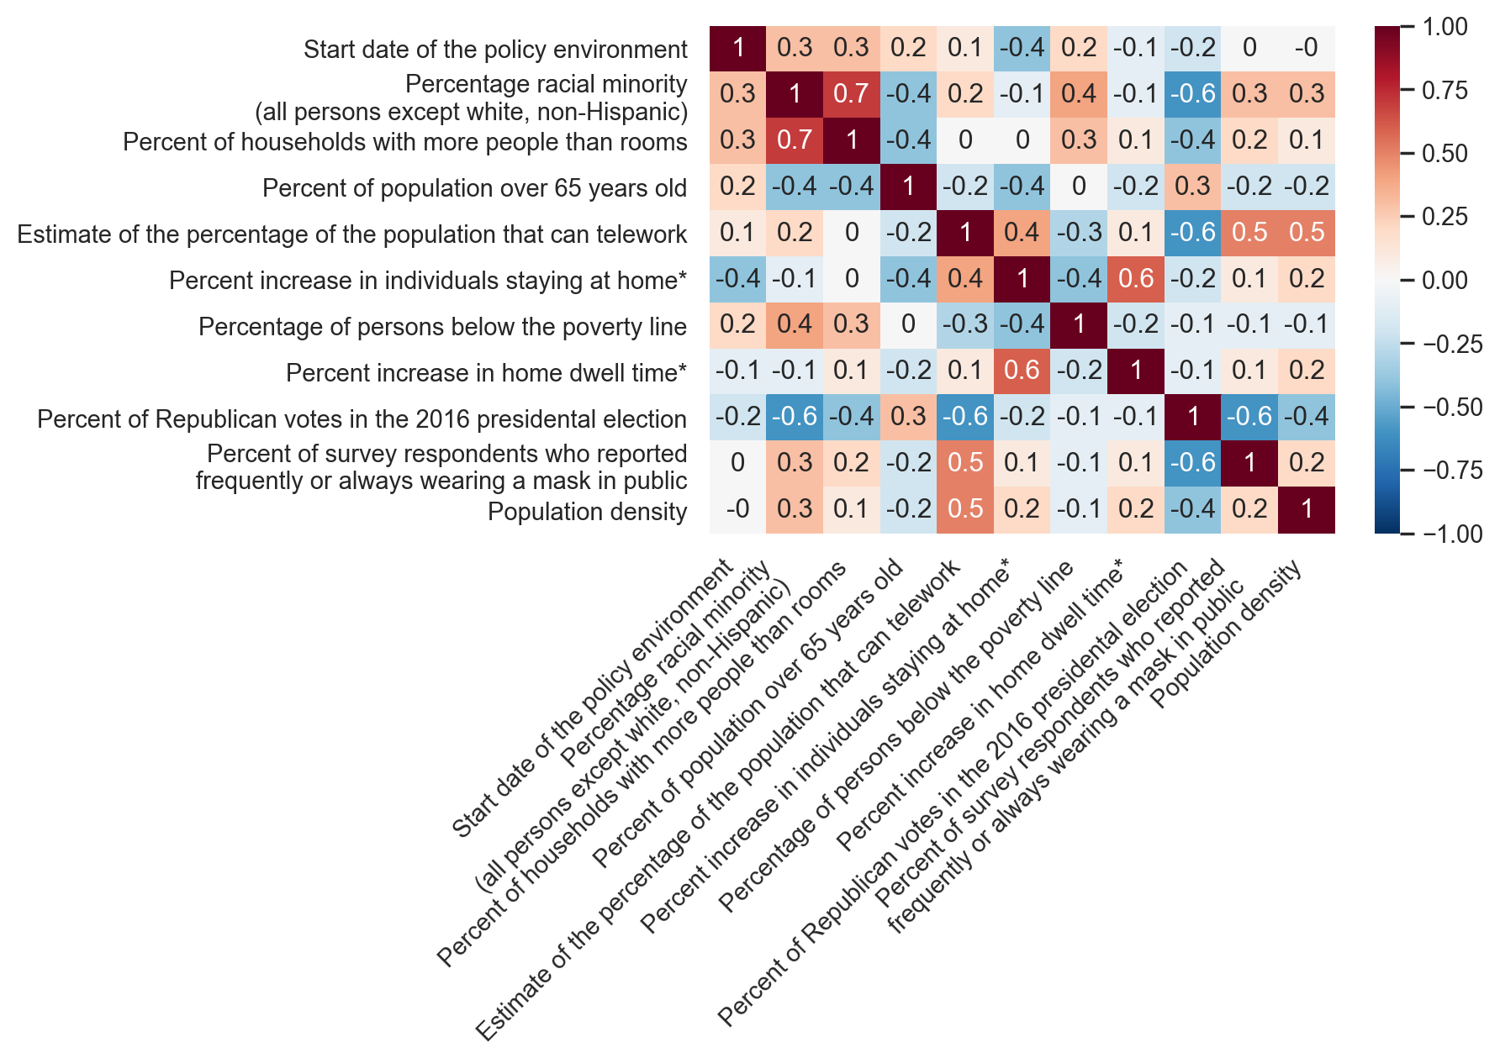
Variable multicollinearity
Perfect positive correlation
Perfect negative correlation
*Percent increase is measured from the first week of January to the first week of April.
Notes:
Now part of the reason, there aren’t a lot of papers that attempt to consider multiple of those variables at once is because most machine learning algorithms and statistical techniques work best when all of the variables that are being used to make the final prediction are independent of each other. It makes it easier to isolate and understand the impact of a single variable on the result. However, human behavior is much more complicated than that, and the way the US is structured means that many of the features that I just outlined are correlated with one another. This chart shows the strength of each of those correlations in the set of 359 counties that were identified by the policy search. For instance, in the upper left conner, we can see that there’s a high correlation between the percentage of people of color and the percent of households with more people than rooms in an area.

Slide 12
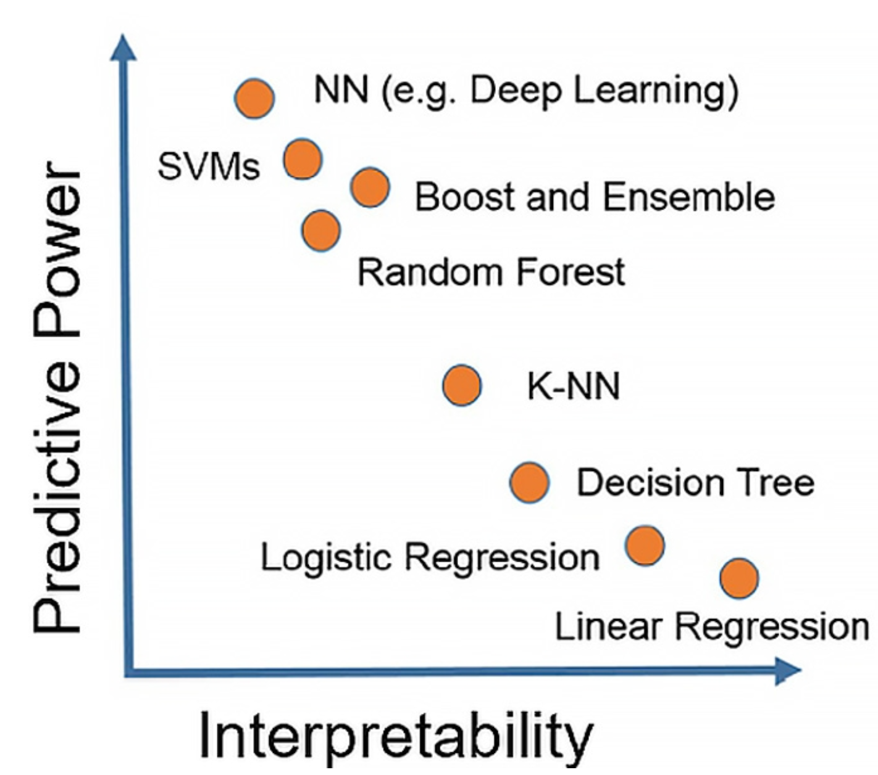
Choosing an approach
Understanding the problem
Regression or classification
Balancing accuracy and interpretability
Well-suited to the data
“If the truth looks like a curve, no straight line can ever get it right.”
Notes:
Once we’ve collected the necessary data and compiled it into a single dataset we have to then decide how we’re going to actually analyze it to answer our question.
First, we have to understand the problem or the question we’re asking. In machine learning there are classification and regression problems. If it’s a classification problem, then we have to group our counties into categorical classes such as “successful” and “not successful” or “high number of cases” and “low number of cases.” That requires us to define what those classes mean. If it’s a regression problem then we’re trying to predict the actual number of COVID-19 cases in the region which may be more difficult.
So not only do we have to consider that, we also have to balance accuracy and interpretability. Some algorithms, like a neural network, do a great job at solving complex problems but not at revealing how exactly each feature informed the network’s decision. For this problem, we wouldn’t necessarily want that. What we’re actually interested in is how these features interact with each other, just how much of an impact socioeconomic status or behavior can have on the number of COVID-19 cases with policies in place. So, we actually might not want the most accurate algorithm here. But we did not something that can accurately predict the cases. If our model is making accurate predictions, if we’ve selected a straight line and the truth is a curve, we can’t draw any meaningful conclusions about the relationship between our inputted variables and our output.
Also what qualifies as “interpretable” can be more of an art than a science. For instance, this chart might say that if we want an interpretable algorithm, we should use linear regression, but in this case our coefficients would actually not be interpretable because most of our inputted features are not linearly independent of each other. It’s not well suited to that type of problem.

Slide 13
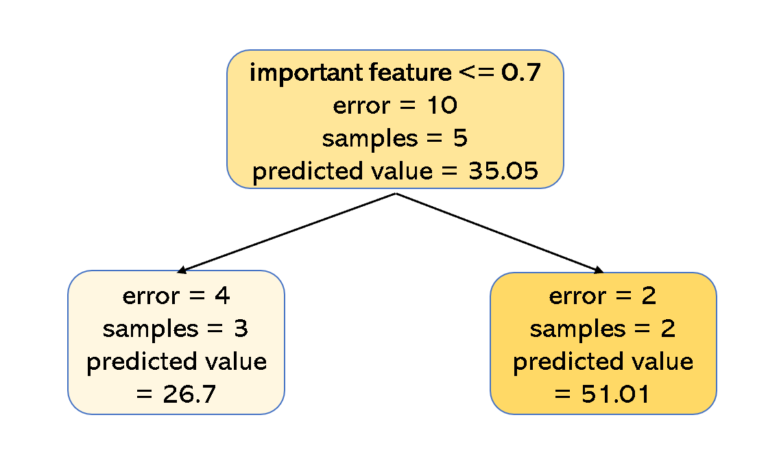
Advantages of a random forest
Can handle multicollinearity
Outputs feature importance
Accurately predicted the outcomes
Single node
in a random forest algorithm
Notes:
While I tried out several different approaches to the problem, the best approach seemed to be treating this as a regression problem, so actually trying to predict the case numbers accurately, and using a random forest model.
A random forest model is an ML model that can handle multicollinearity well. At each step, the model splits the data according to the value of a single feature and always chooses the feature that best reduces the error in its prediction. So, it can handle features that are correlated with one another better than other algorithms since it’s considering them one by one.
Also, it can then output a measure of feature importance according to how much each inputted variable reduced the error in the final prediction.
And when experimenting with the data, I found that it got a fairly high degree of accuracy.

Slide 14
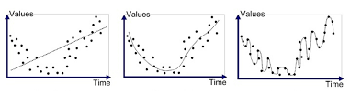
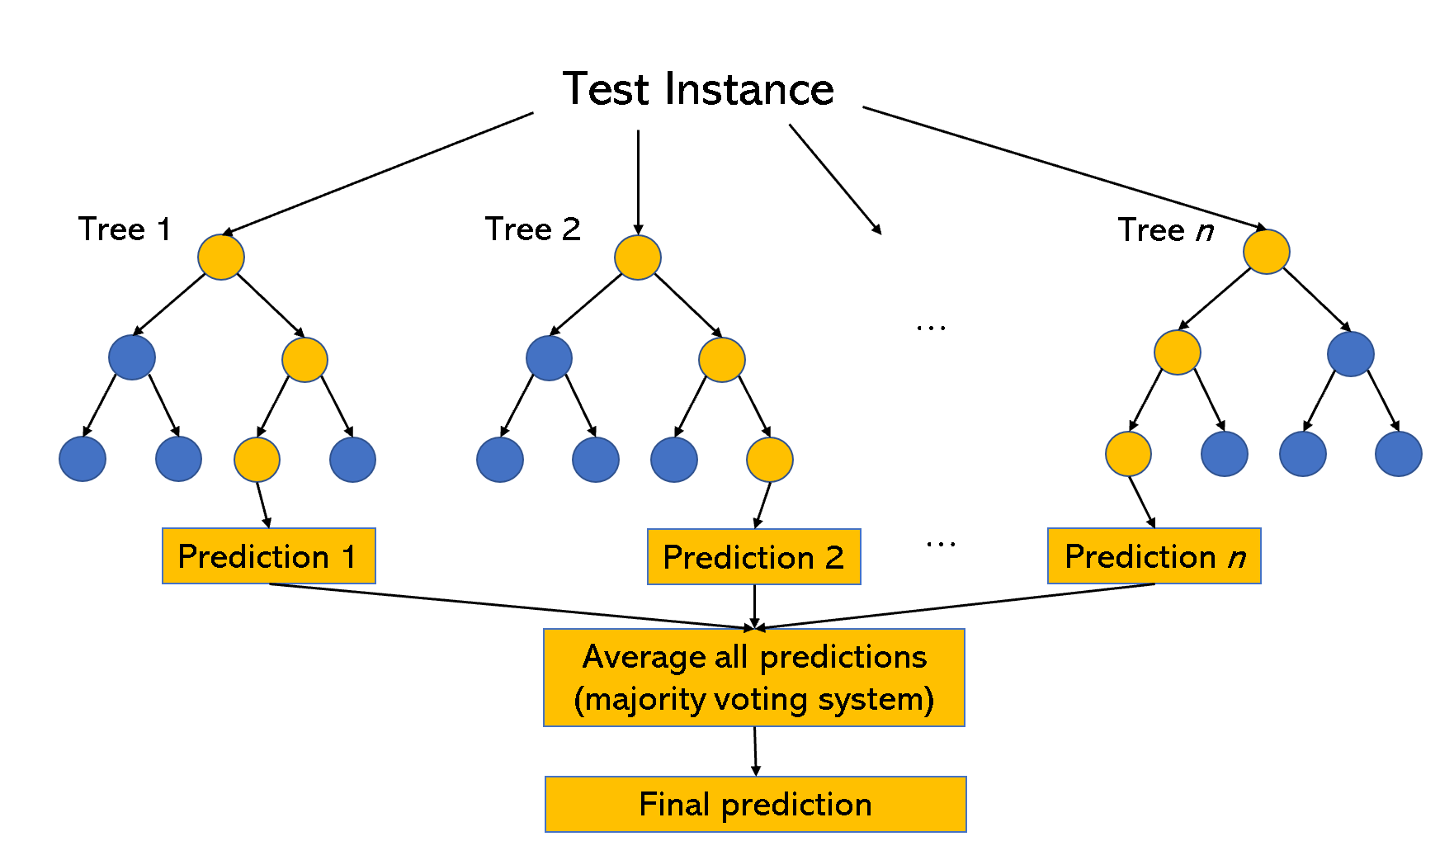
Random forests
Composed of many decision trees
Trees learn to make predictions according to variable values
Each tree in the ensemble is trained on a random subsample of the dataset
Underfitted
Good Fit
Overfitted
Overfitting example
Random forest
Notes:
To expand on that brief overiew, a random forest is a model that’s composed of many decision trees, which is another more simple ML algorithm, so it’s what’s known as an ensemble learning technique. The decision trees learn to split the data at each level in the tree and make predictions according to the value of the inputted features. When we then input an unseen instance into the model, each tree in the ensemble makes a prediction about the value and all of the predictions are then averaged into a single prediction.
What makes this algorithm so effective is that no single tree is trained on the entirety of the data or all of the features in the data. Each tree in the ensemble is trained on a randomly selected subset of the training data. This means that the trees are uncorrelated which improves the final prediction and reduces the possibility of overfitting the training data. Overfitting is when a learning model works great on data that it was trained on, but is not able to make good predictions on unseen data. Therefore, you usually have to check the performance of the algorithm by holding out some of your data as a “test set” and then only constructing the algorithm from the remaining “training set.” In this study, I used a 70 – 30 train test split, so 70% of the data is in the training and 30% is in the test.

Slide 15
Measuring the impact of COVID-19
Case data was retrieved from the New York Times COVID-19 Github repository
Information about caseload in the county had to be reduced to a single feature
Notes:
However, one limitation of a random forest model is that it can only predict a single value. The model can’t output a graph of what an area’s epidemic curve is going to look like. So in preparing the data, I had to construct a single value that could capture the area’s epidemic curve. To do so, I calculated a value that will refer to as average new COVID-19 cases or just average new cases. This value is how many new COVID-19 cases were observed each day that the policy was in effect and 2 weeks after the policy expired on average. 14 days is the upper limit on how long it take the virus to incubate after an exposure, so incorporating this lag time can capture any exposure that occurred during the policy period but was not caught until afterward.
All case data was retrieved from the New York Times COVID-19 repository and the entire study was conducted at the county-level because that is the smallest geographical unit for which COVID-19 caseload data is available nationally.

Slide 16
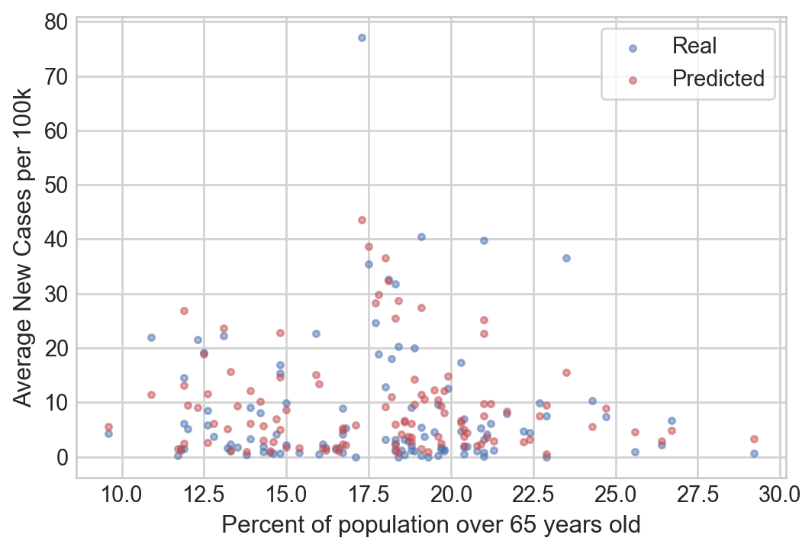
Running the model on data during all waves of the pandemic
Features are accounting for approximately 60% of the variance in the test set (R²=0.6, OOB = 0.64)
Predicting the outcome within 4.9 cases per 100k people (AME)
Test dataset (n = 108)
Notes:
So how well did the model perform? So this is the results of the model on data from all waves of the pandemic.
The scatterplot shows how close the predicted values were to the real ones and we can see that the model had an absolute mean error of about 4.9 cases per 100,000 people. We can also see how much of the difference between counties or how much of the variance was accounted for by our inputted features.
R-squared percentage of the variance the model is explaining in the test set. The OOB score is the algorithms estimate of how well it would perform on unseen data.
So we can see we’re starting to get promising results.

Slide 17
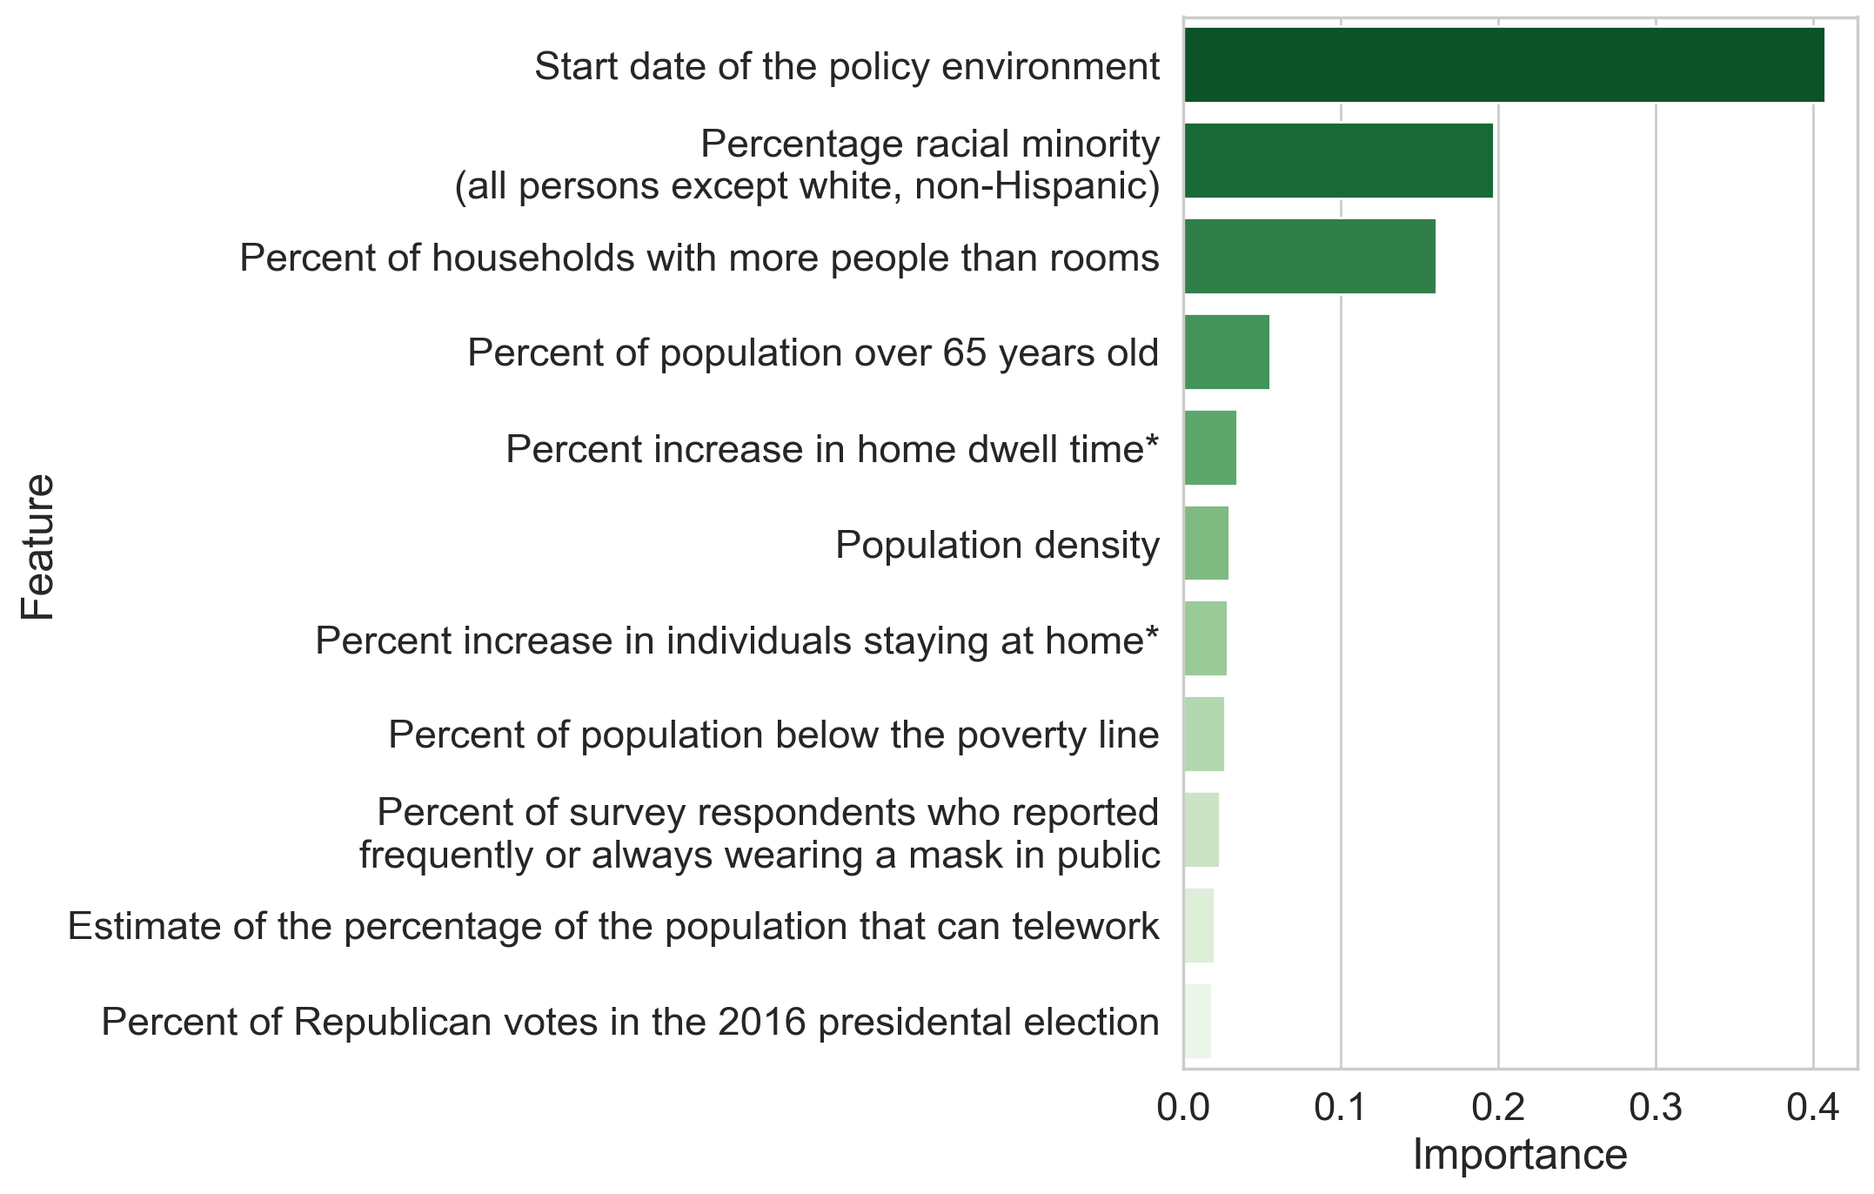
Understanding feature importance
Model outputs a graph showing what percentage of the variance each feature explained
Start date is most important
Notes:
However, when we look at feature importance or the percentage of the captured variance that each feature is explaining, we can the start date of the policy environment is explaining most of the variance, it’s most important to accurately making that prediction which is a little odd because that’s the one policy variable I elected to include. So what does that mean?

Slide 18
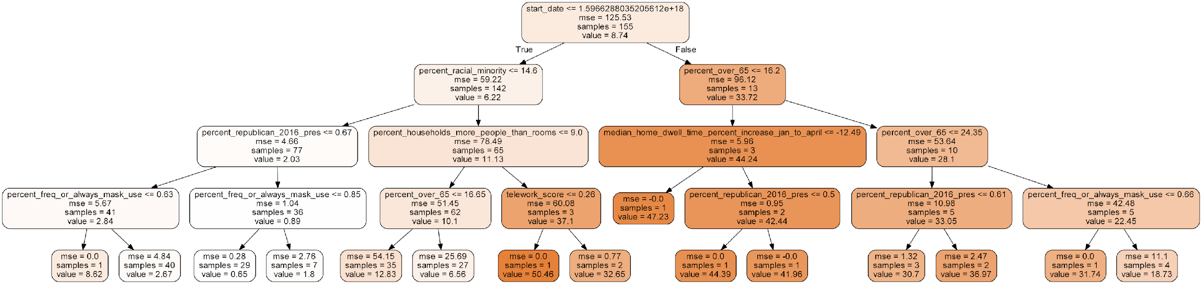
Visualizing individual trees within the larger forest
When is the tree splitting on the input variable?
Only splitting on start date at the top
August 8th, 2020
Notes:
Well one way I investigated that question is by visualizing a single decision tree in the ensemble. A random forest consists of 1000s of trees each with many nodes, but we can pull out smaller decision trees from that larger ensemble. Notice how the tree is only splitting on start date at the very top.

Slide 19
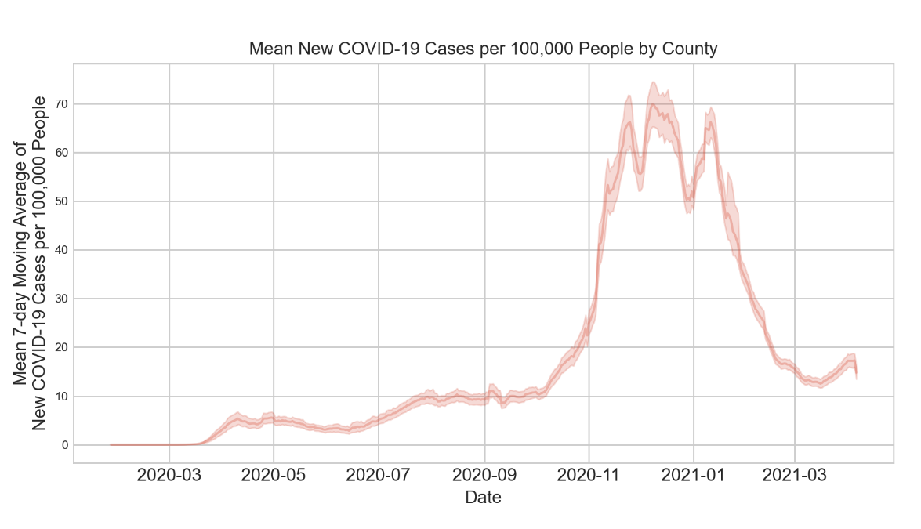
Importance of the policy environment’s start date
Policy timing? Or differentiating between pandemic waves?
To test, we split the dataset and ran the model again
Notes:
So why is start date so important, why is it the first variable split on, well if we look at this time series graph of new COVID-19 cases in the counties studied we can see that were many more cases on average in the fall then there were in the spring and summer. So to better understand why start date was so important was I capturing the importance of policy timing or just the pandemic wave? I split the data manually into a spring and summer dataset.

Slide 20
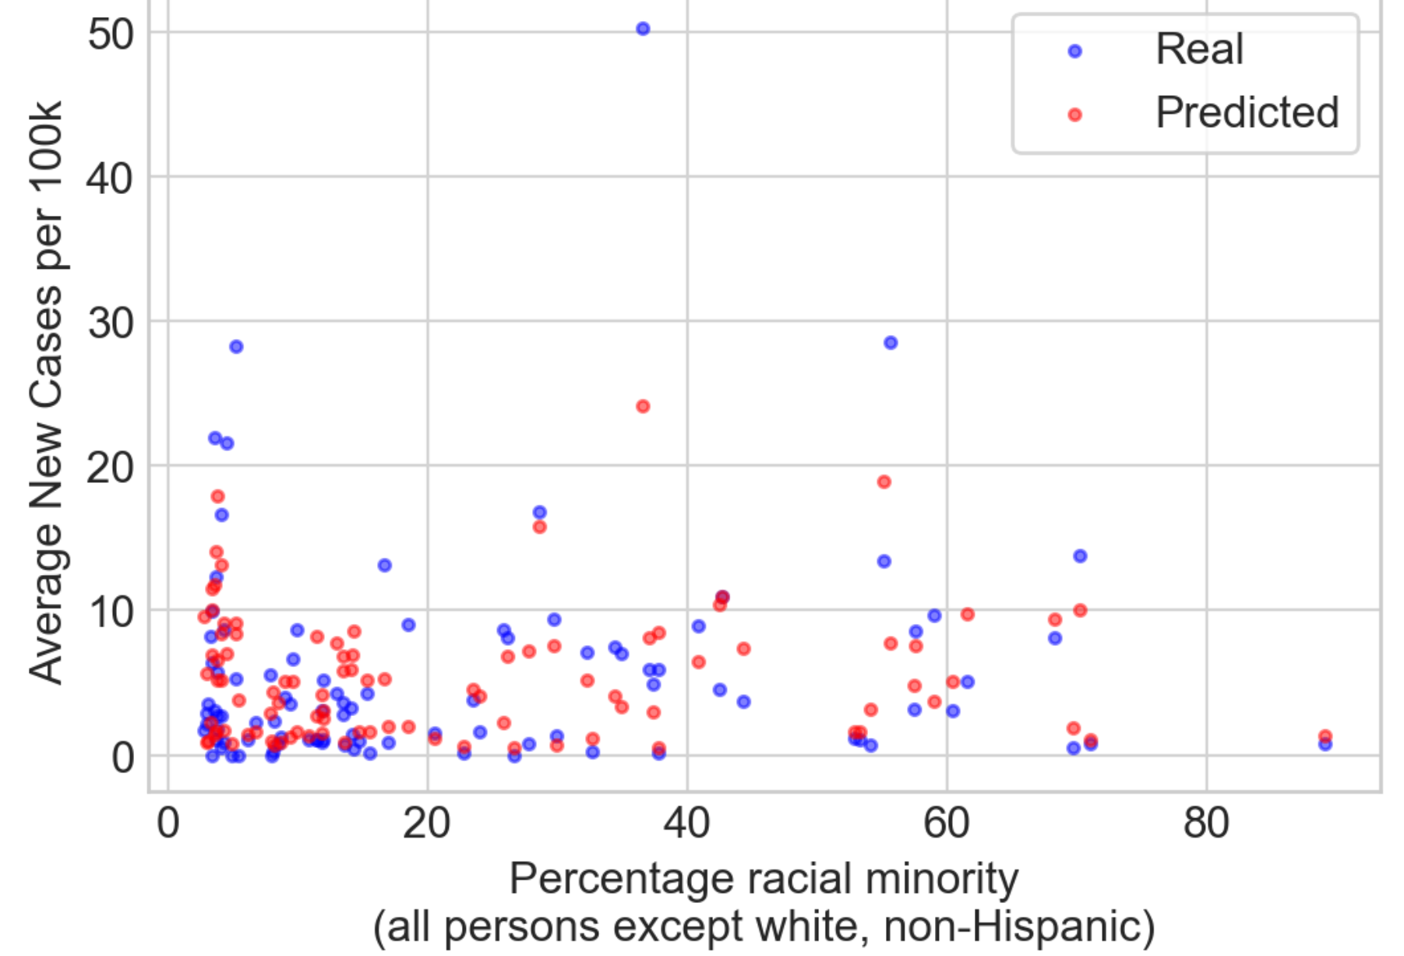
Results on the spring/summer dataset
Reduced the dataset from 359 counties to 326
AME = 3.6 cases per 100,000 people
Explaining about 40% of the variance (R²=0.41, OOB = 0.48)
Test dataset (n = 97)
Notes:
Studying only the counties that had social distancing policies in place during the spring and summer reduced the dataset from 359 counties to 326. It also reduced both the absolute mean error and the percentage of the variance being explained by the model. We expect that the variance being accounted for would be lower. We know start-date was explaining a lot and we just dimished it’s importance. However, 40% is not low. If we’re attempting to study something as complex as human behavior and viral transmission, we would expect an R-squared score that’s on the lower side.

Slide 21
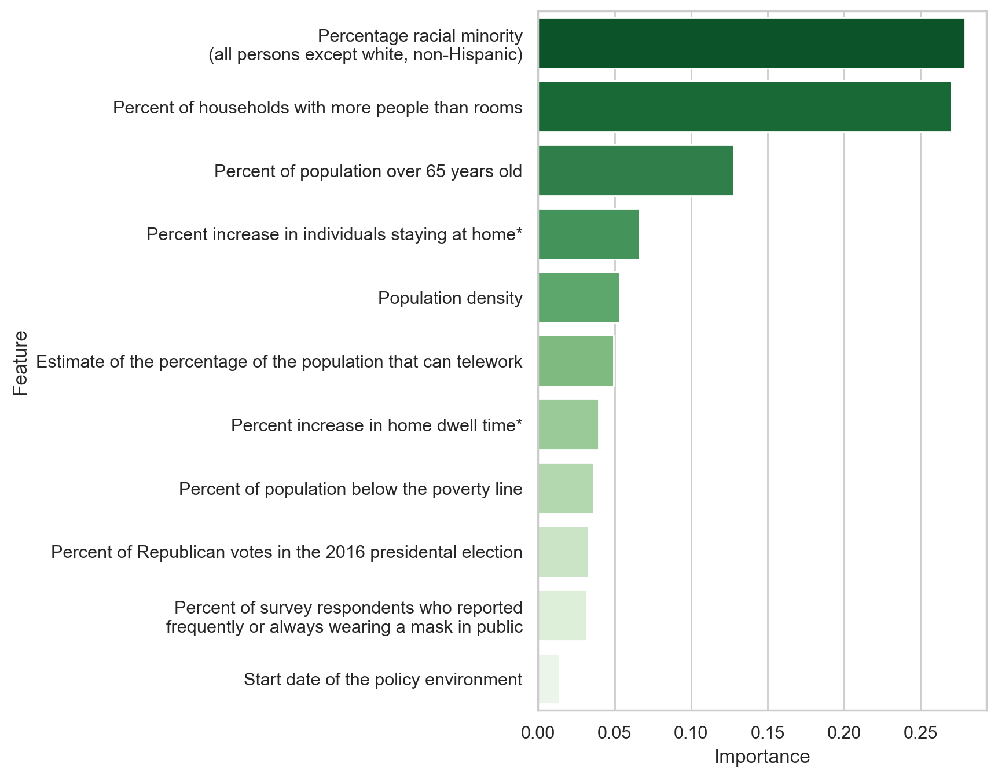
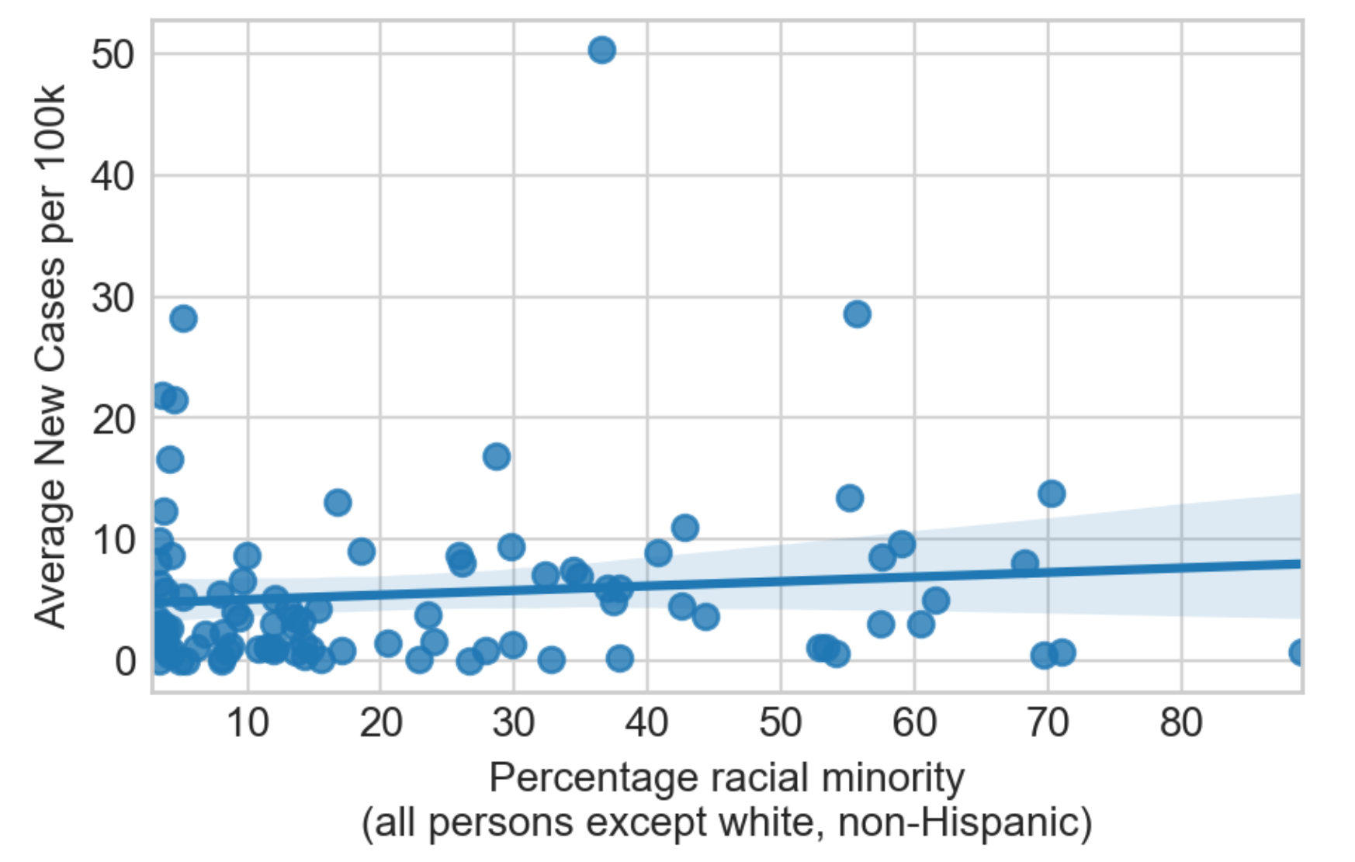
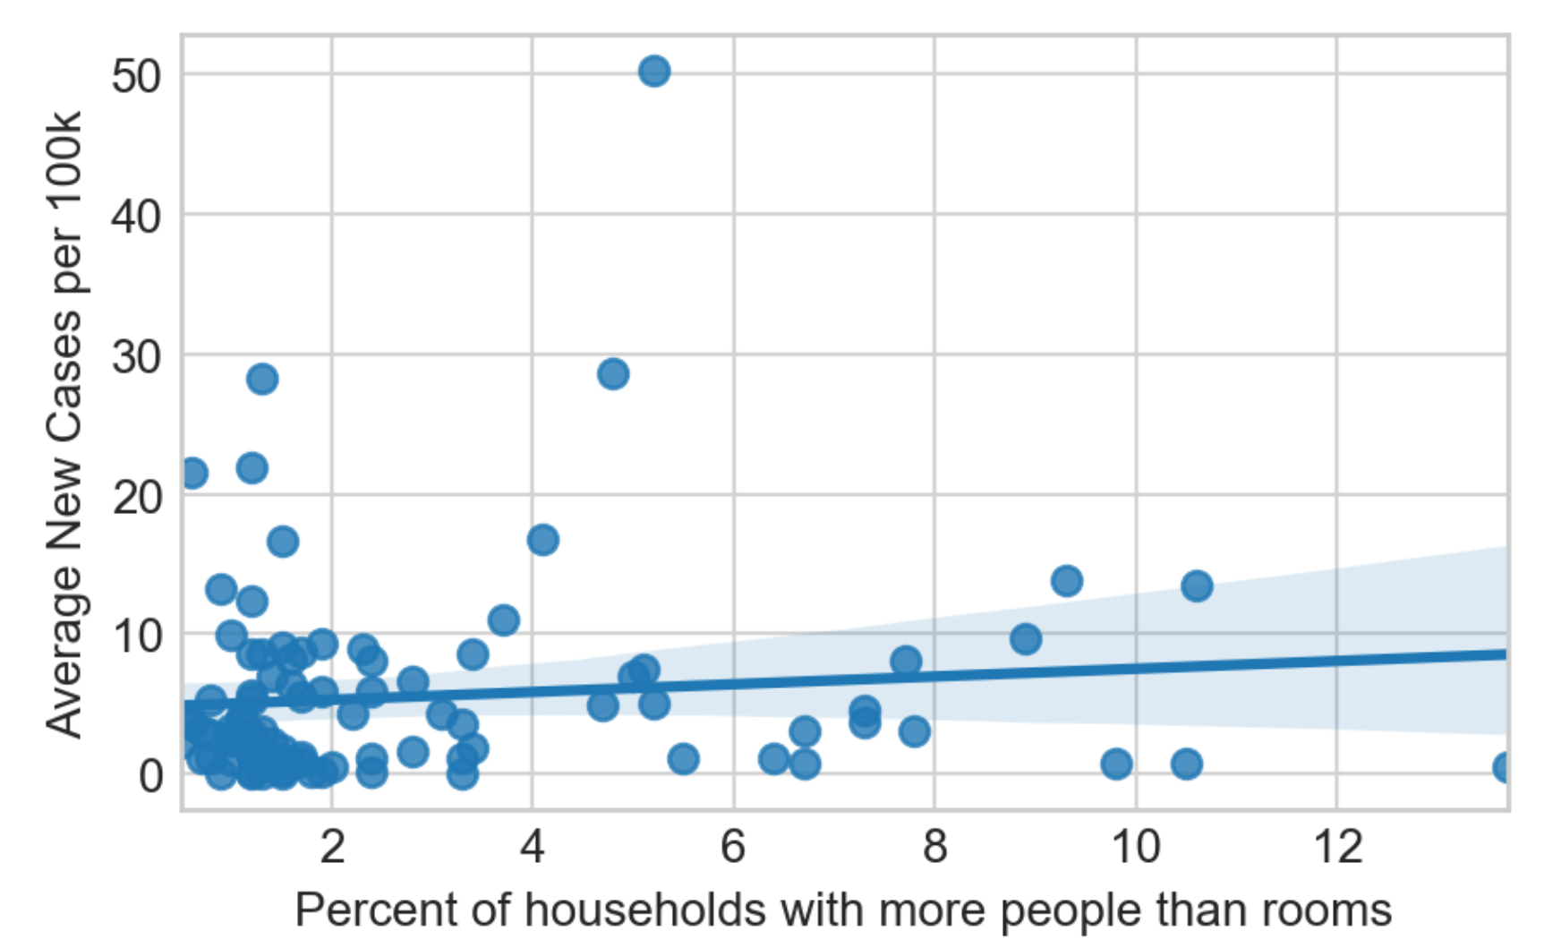
Percent racial minority has the most explanatory power in the spring/summer
Test dataset (n = 97)
Notes:
What’s now explaining that variance. It’s the percentage of people of color living in the area and the percent of households with more people than rooms. And when we look at even just the test set, we can see a slight correlation between the average number of new COVID-19 cases and those two values. And this is sadly not an unexpected result.

Slide 22
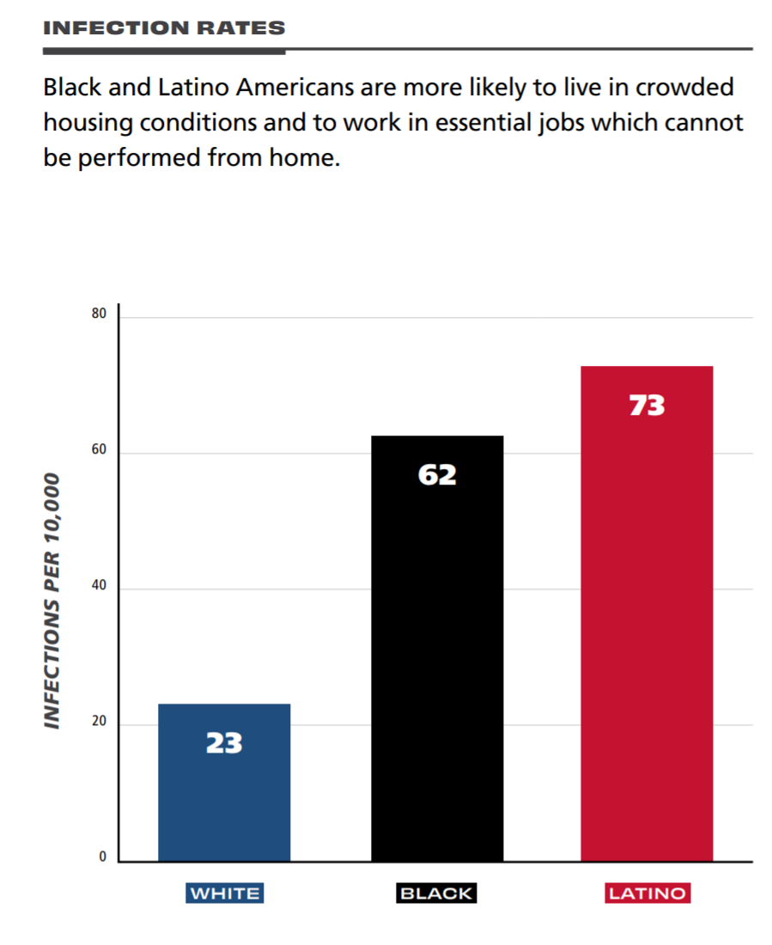
Racial disparities in COVID-19 infections
Higher rates of COVID-19 infection amongst Black and Latinx people
Hospitalization rates among Black and Hispanic Americans are 4.5 and 3.5 times higher respectively than those of white Americans
Source: The National Urban League
Notes:
People of color, but especially Black and Hispanic Americans, have been disportionately impacted by COVID-19. There are higher rates of COVID-19 infection amongst these populations and the CDC even found that age-adjusted COVID-19 hospitalization rates for Black and Hispanic Americans were 4.5 and 3.5 times higher respectively than those of white Americans, as of May 30, 2020.

Slide 23
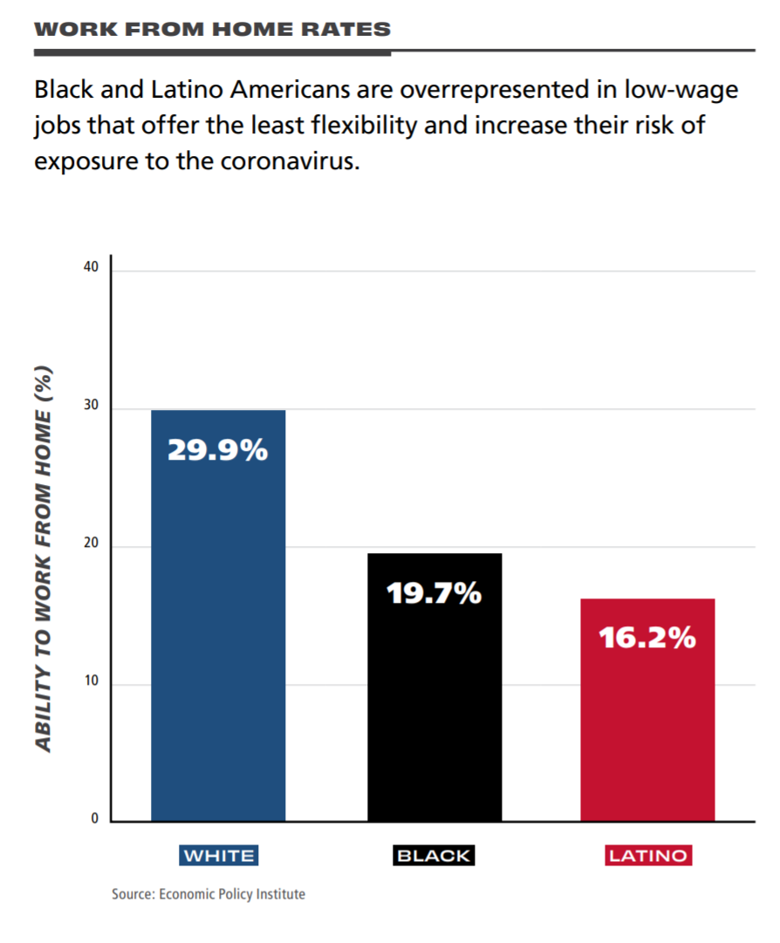
Percent racial minority correlates with several other risk factors of COVID-19 infection
Black and Latinx Americans are more likely to work in occupations that cannot be conducted from home
More likely to live in crowded, multigenerational households
Notes:
This occurs for a variety of reasons and there’s some disagreement as to what’s most important, but being a racial or ethnic minority correlates with several other risk factors of COVID-19 infection because of a legacy of legal segregation and modern day discrimination and inequity. Black and Latinx Americans are more likely to work from occupations that can’t be conducted from home. They are more likely to live in crowded, multigenerational households. And what our model is finding is that it correlates with so many risk factors that race has more explanatory power than these factors alone

Slide 24
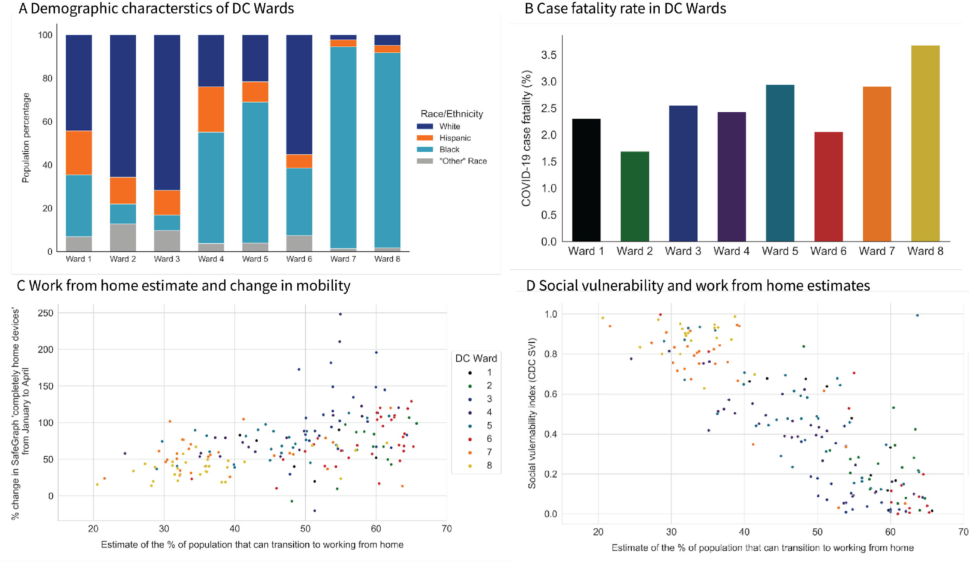
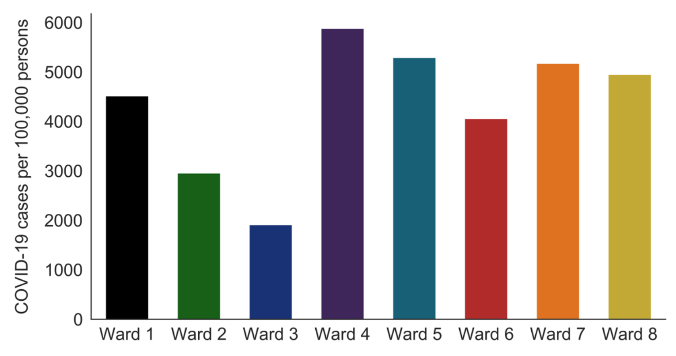
Case study: Washington DC
Local areas (wards) with higher proportions of Black and Hispanic residents had more cases
Correlations were found between the telework estimate and social vulnerability
A Demographic characteristics in DC Wards
B Cases per 100,000 people in DC Wards
C Work from home estimates and change in mobility
C Social vulnerability and work from home estimates
Notes:
As a case study, we can also consider Talus Analytics analysis of the DC area. Where wards with a lower proportion of white residents also saw higher case numbers. At the census tract level, we also looked at who had the privilege of working from home and found that census tracts with more people working from home and staying inside also were rated lower on the CDC social vulnerability index.

Slide 25
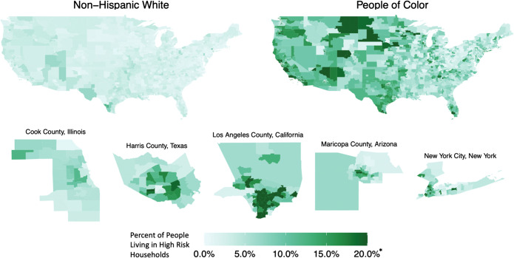
People of color often live in high-risk households
“People of color (POC; 39% of the total population) account for 76% of those in high-risk households”
High risk households are defined as households with more people than rooms and at least one essential worker in residence
Notes:
At the county-level people of color account for over 76% of those people living in high risk households where a high risk household is defined as one with more people than rooms and at least one essential worker in residence.
This relationship was supported by our own preliminary analysis. In the data that the model was trained on we found a strong correlation between the percent racial or ethnic minority and the number of households with more people than rooms

Slide 26
COVID-19 spread may be driven by workplace and household infections
COVID-19 continued to circulate amongst people who could not effectively social distance due to the size of their household and/or the nature of their job
“This is really is about who still has to leave their home to work, who has to leave a crowded apartment, get on crowded transport, and go to a crowded workplace…” – Dr. Mary Basset
Notes:
Our study suggests that when social distancing policies are implemented, the virus primarily continues to spread through the households of marginalized individuals. In the spring, when non-essential businesses closed and the general population was told to stay inside, COVID-19 continued to circulate amongst people who could not effectively social distance due to the size of their household and/or the nature of their job. The pandemic and our policy response to the pandemic thus exposed and heightened existing structural inequalities. In the words of Dr. Mary Bassett, the Director of the FXB Center for Health and Human Rights at Harvard University, it “makes me angry, because this is really is about who still has to leave their home to work, who has to leave a crowded apartment, get on crowded transport, and go to a crowded workplace, and we just haven’t acknowledged that those of us who have the privilege of continuing to work from our homes aren’t facing those risks.”

Slide 27
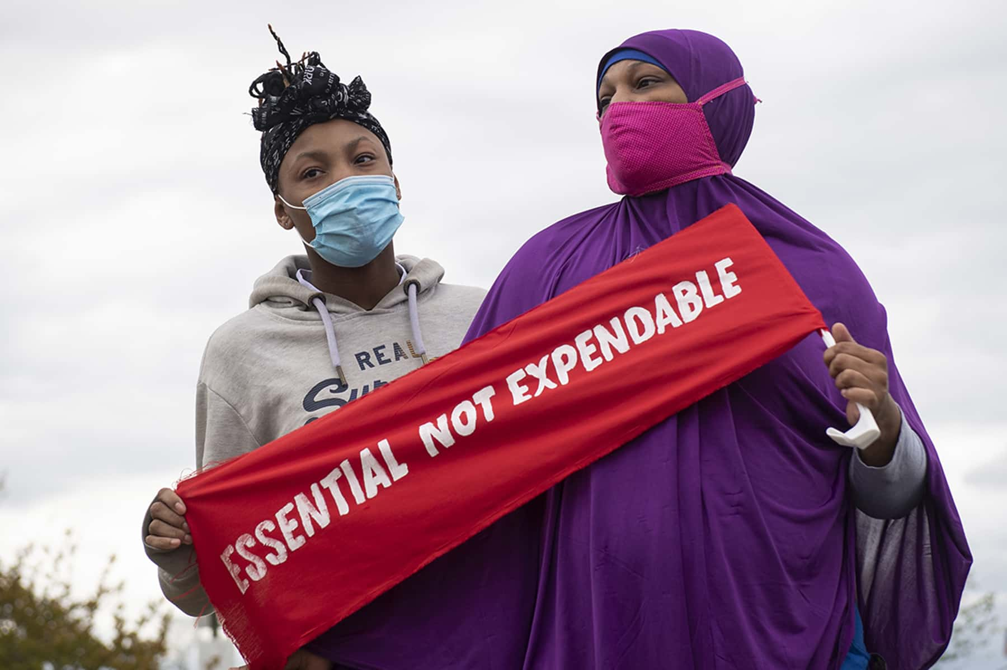
Takeaways for decision makers
Must consider how to protect vulnerable populations in addition to enacting social distancing policies
Medicaid expansion in the US
Aid, social services, additional protection measures, paid sick leave
Notes:
In future pandemic situations, we cannot repeat these same mistakes. We cannot design and implement policy that fails to protect people that are already marginalized. Truly tackling these issues may require major reforms, but several groups have already proposed policy solutions that could protect vulnerable individuals in the short term. Zhang et al. recommended an expansion of Medicaid after finding that the COVID-19 daily growth rate decline in states with a higher percentage of essential workers enrolled in Medicaid. They also recommend mask mandates as a means of protecting people in the workplace. UN provides other recommendations based on practices that have worked internationally, such as allocating aid, expanding social services, and providing additional protection measures.

Slide 28
Conclusions
The COVID-19 epidemic has highlighted existing inequities
The racial makeup of a population has been found to have a lot of explanatory power in predicting new COVID-19 cases while a policy is in place
Essential workers may become infected at work and then spread the virus through a crowded household
Must better protect vulnerable populations

